Slide 1

Core Workshop 4: Polynomial Regression

Slide 2
Overview
Real World Application
Linear Regression: Recap and Problem
Solution: Polynomial Regression
Overfitting/Underfitting -> Hyperparameters
Cross Validation

Slide 3

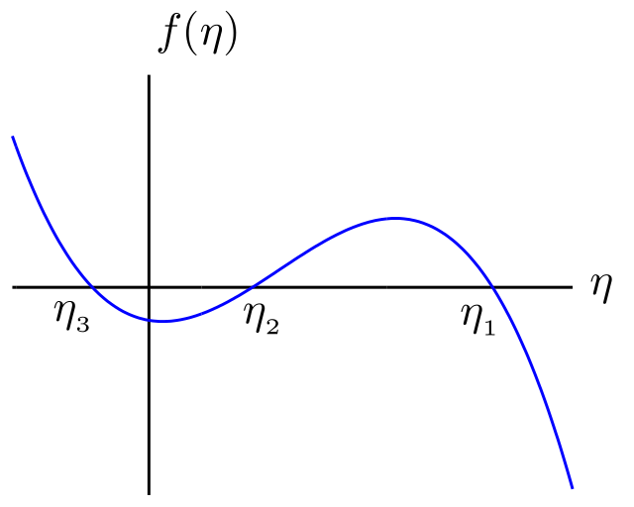
Polynomial regression in real world

Slide 4

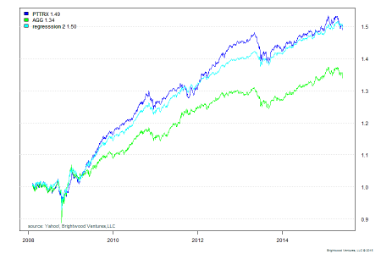
E.g. Wealth Management
BrightWood
Funds performance
Statistical model on benchmarks
More in: http://www.brightwoodventures.com/evaluating-fund-performance-using-regression/

Slide 5
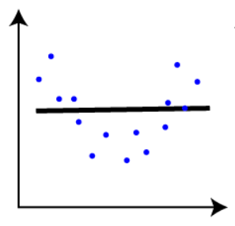
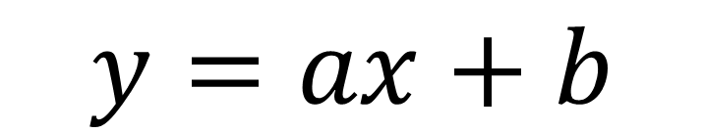
Linear Regression: Recap and Problem
$$y=ax+b$$

Slide 6
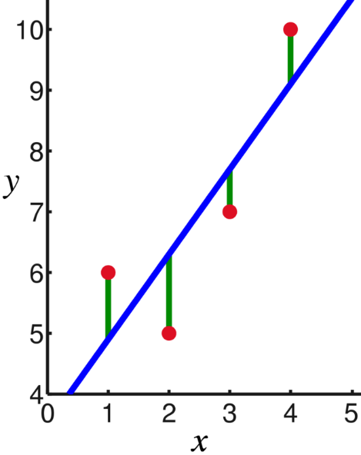

Quick Recap
Supervised
Feature and label
$y=ax+b$
Smallest loss for least squares
Example: People->Pizza

Slide 7
Problems?
What if curved?
Structure differs from straight line
Underfitting
Height vs Weight live code

Slide 8
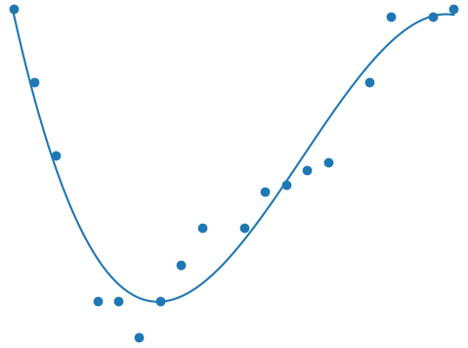


Solution: polynomial regression

Slide 9
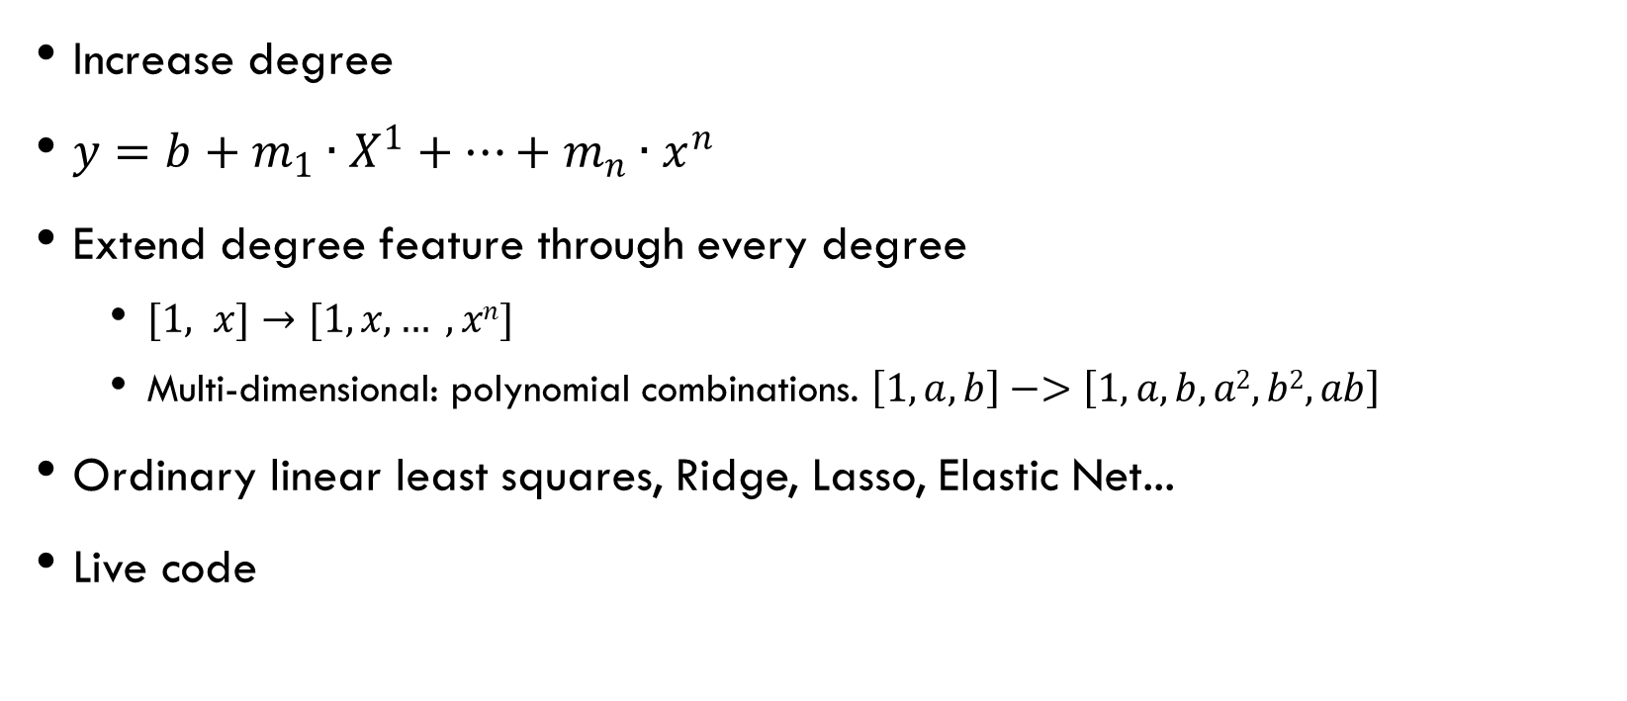
Polynomial feature
Increase degree
$y=b+m_{1}∙X^{1}+⋯+m_{n}∙x^{n}$
Extend degree feature through every degree
$[1, x]→[1, x, … , xn]$
Multi-dimensional: polynomial combinations. $\left[1, a, b\right]−>\left[1, a, b, a2, b2, ab\right]$
Ordinary linear least squares, Ridge, Lasso, Elastic Net...
Live code

Slide 10
Polynomial interpolation
Straight lines joint rather than curves
Use polynomial interpolation to smoothen
Live code

Slide 11
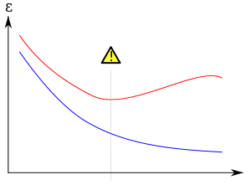

Over/underfitting and hyperparameters

Slide 12
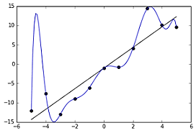

Underfitting vs overfitting
Which degree?
Underfitting
Not enough trained
Overfitting
Too well trained
Find a balance

Slide 13
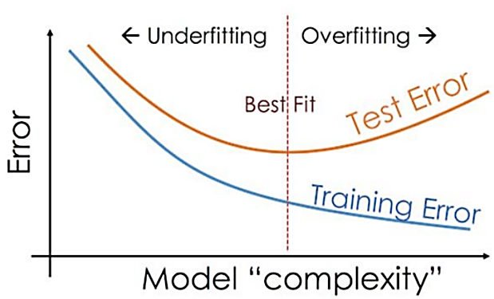
Hyperparameters
Parameters: what model optimizes
Hyperparameters: how model looks like, structure, learning process
Best balance between train loss and test loss

Slide 14
Cross validation

Slide 15
Validation process
How to optimize polynomial feature?
Validation set and test
Iterate through hyperparameters to find the best
Find best parameter for certain hyperparameter
Validate with validation test
Find best hyperparameter
Train
Validate
Test

Slide 16

K-folds cross validation
K-folds
Cross validate
Least loss average hyperparameter
Live code
Source: sklearn, https://scikit-learn.org/stable/modules/cross_validation.html

Slide 17

The end, thanks for your attention!
Any questions?

